Slide 1
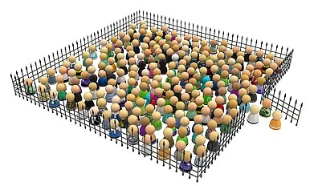
CROWD CONTROLLER USING IR SENSORS AND ARDUINO
GUIDED BY:-
Mrs.P.Y.VANI MAM Lecturer

Slide 2




Project analysis slide 2
CONTENTS
FUTURE SCOPE OF PROJECT
ABSTRACT
PROJECT PROTOTYPE
BLOCK DIAGRAM
PROJECT
APPLICATIONS
COMPONENTS REQUIRED
ADVANTAGES
CIRCUIT DIAGRAM & WORKING

Slide 3
Project analysis slide 3
ABSTRACT
Many times we have seen that a gatekeeper or security guards who controls the people in overcrowded areas like shopping malls , political meeting , events, temples etc., But in some cases manually it is not possible to have an accurate count of the people entering or leaving the area . thus it will lead to over crowded accidents(like human stampede).
So Inorder to solve this problem we came up with a digital circuit , which will give a clear analysis about the population in a particular area . It will count and display the number of people entering , leaving the area and present inside the area . It is also capable of indicating overcrowd alert with the help of a buzzer and LCD.

Slide 4
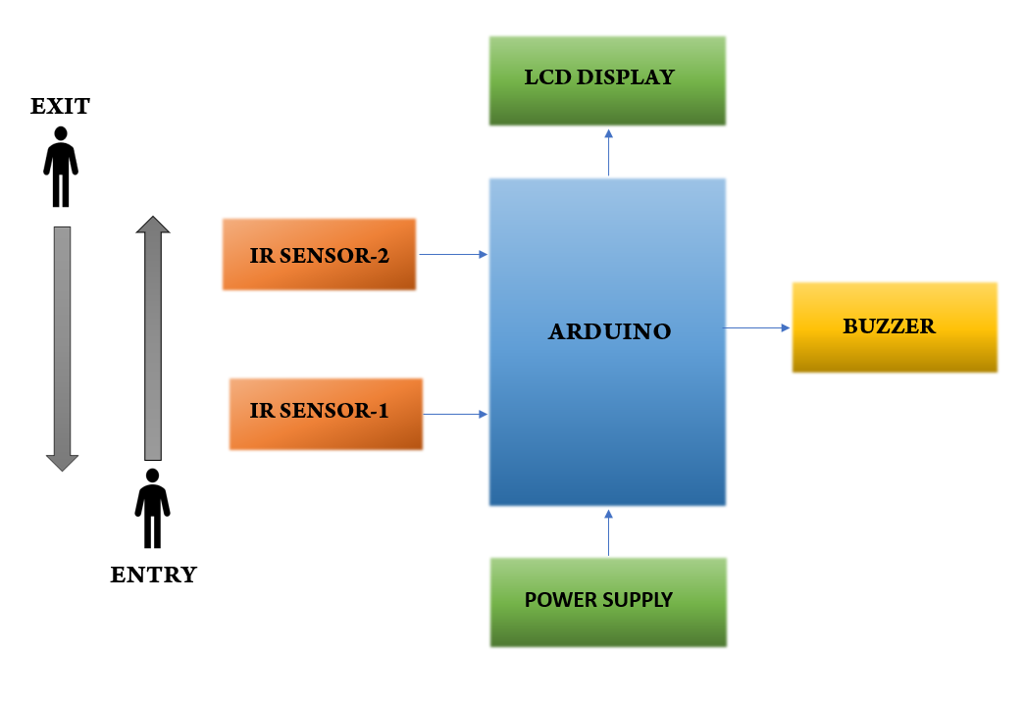
Project analysis slide 3
Block diagram

Slide 5
Project analysis slide 11
Required components
HARDWARE COMPONENTS
SOFTWARE USED
Arduino ide software
Embedded c language
Arduino-UNO R3 board -1
IR Sensors -2
16x2 LCD display -1
Buzzer -1
10k potentiometer -1
9v power adaptor -1
Arduino cable -1
Bread board -1
Male to male jumper wires -few
Male to female jumper wires -few

Slide 6
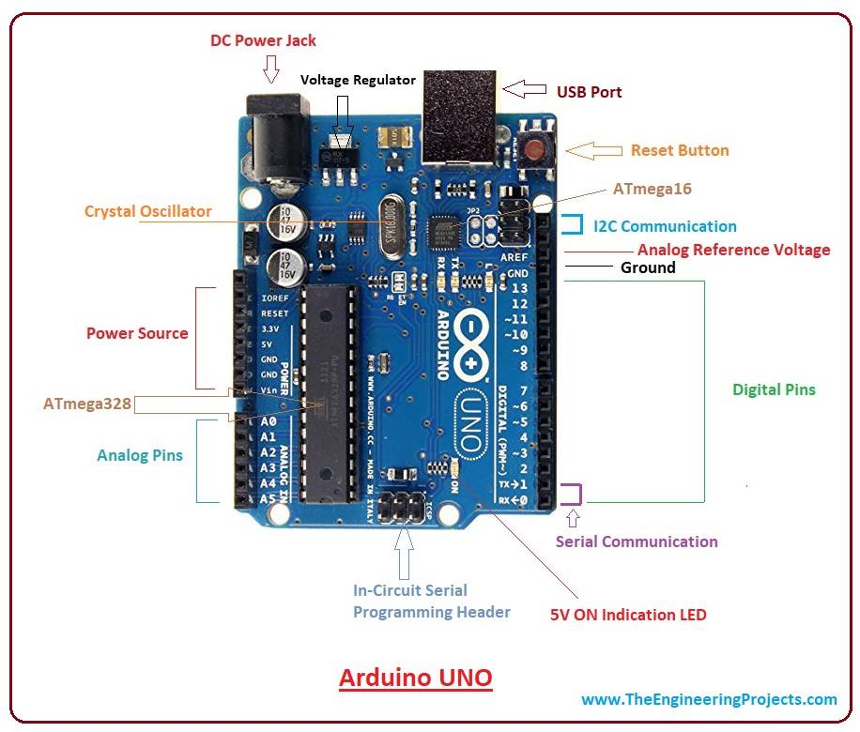
Project analysis slide 3
Purpose of each component
Arduino-uno board
The Arduino UNO is a flexible, easy-to-use programmable and open source microcontroller board based on the Microchip ATmega328P microcontroller.
Specifications:-
Input voltage- 6-20 v , Input current- 20 amp
clock frequency- 16M HZ
Use of the component in the circuit:
In this project we have connected the LCD, IR sensors , buzzer and other components to this Arduino. The source code is also dumped into the Arduino.

Slide 7
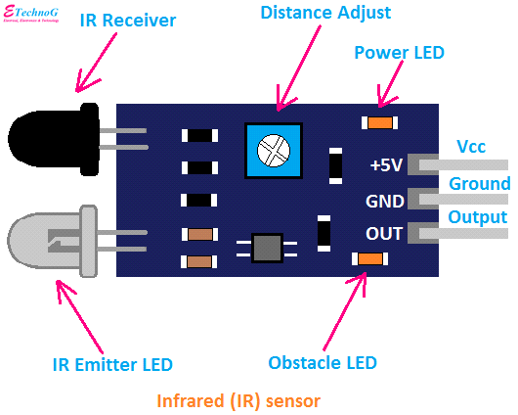
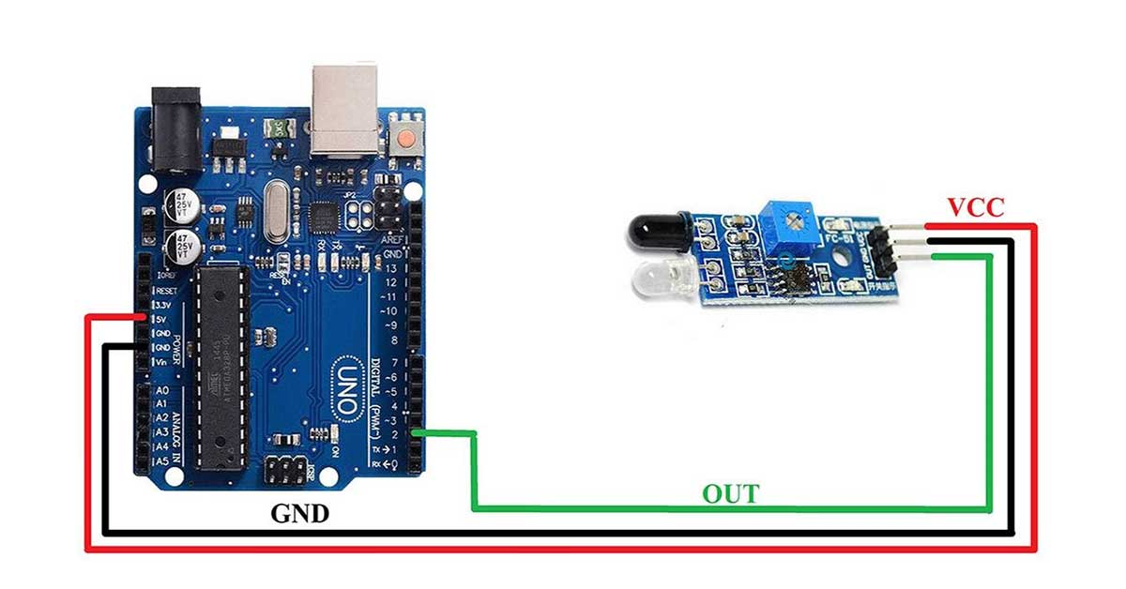
Project analysis slide 3
Purpose of each component
IR SENSOR
Infrared (IR) sensor module is a distance proximity sensor “switch”.
It uses the electromagnetic reflection principle.
The IR sensor gives an electrical signal as an output when an object comes in front of it.
Specification:-
Operating voltage- 5v , Distance measuring range- 20 cm
Connection of IR sensor in the circuit:
As shown in the figure the vcc and ground terminals are connected to +5v and gnd respectively . The output terminal is connected to pin 2 of arduino.

Slide 8
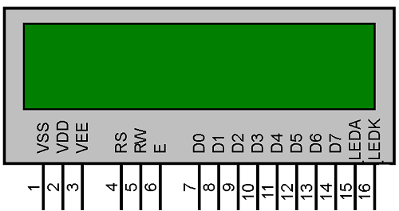
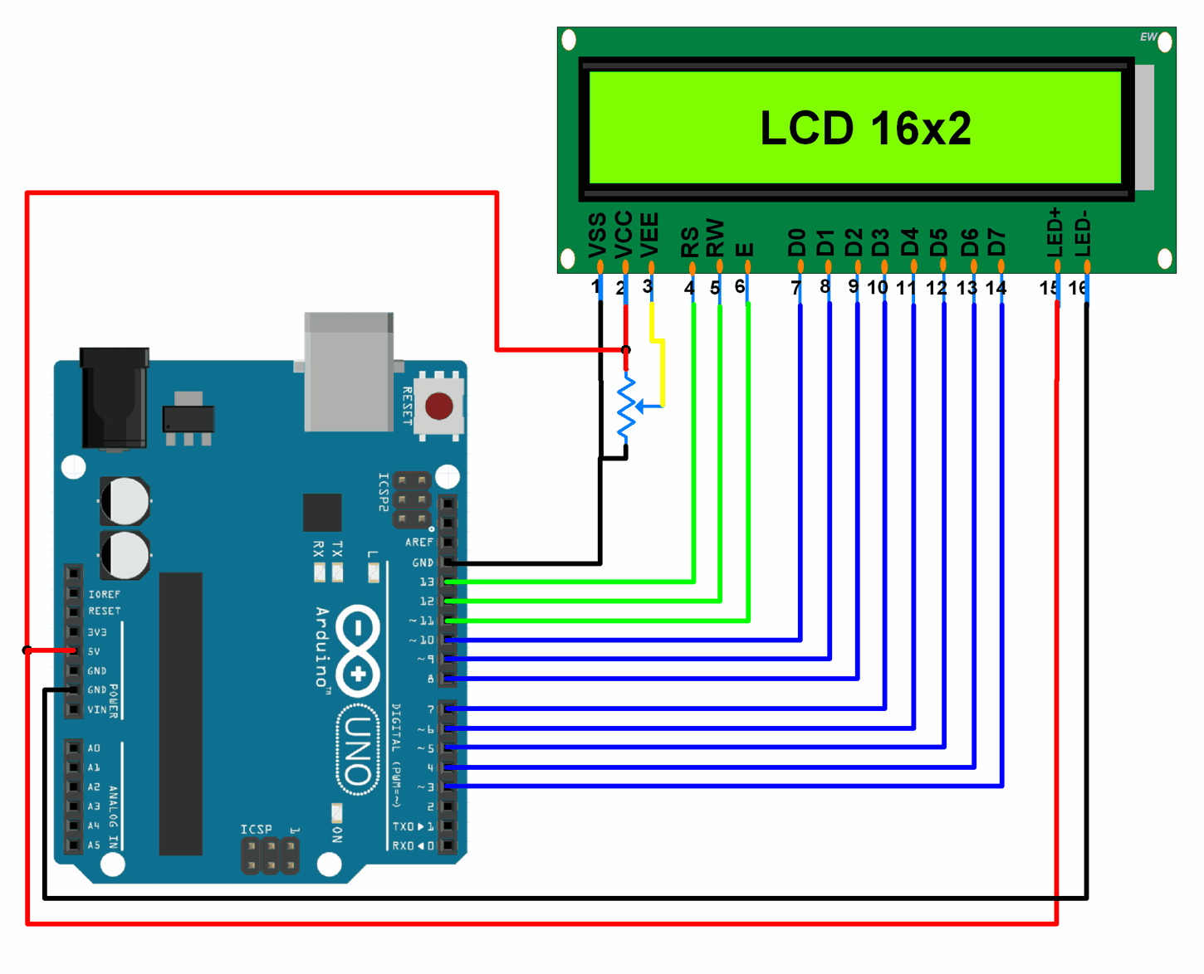
Project analysis slide 3
Purpose of each component
16x2 LCD display
LCDs (Liquid Crystal Displays) are used in embedded system applications for displaying various parameters and status of the system.
Specification:-
Operating voltage- 4.7-5.3V , operating current- 1amp
Connection of LCD in the circuit:
Connect LCD RS pin to digital pin 12,Enable pin to digital pin 11,D4 pin to digital pin 5,D5 pin to digital pin 4, D6 pin to digital pin 3,D7 pin to digital pin 2,R/W pin to GND,VSS pin to GND, VCC pin to 5V respectively.

Slide 9
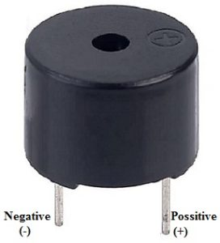
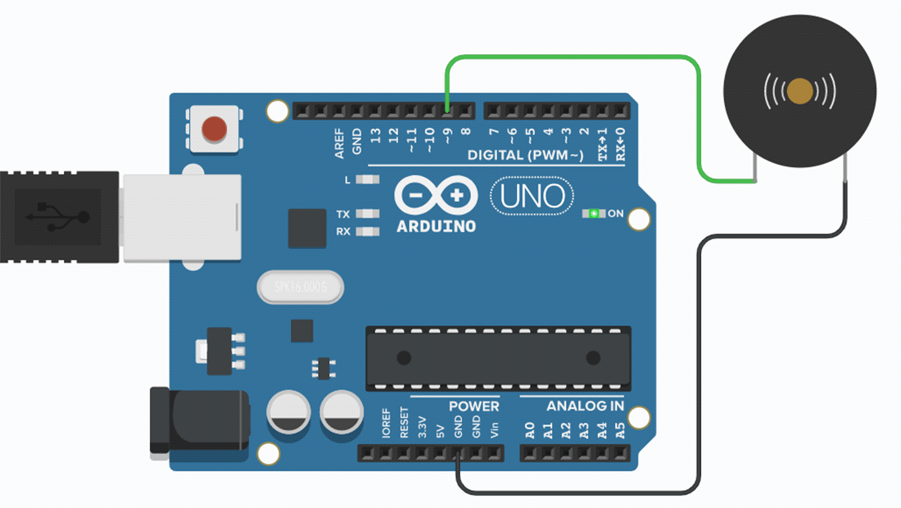
Project analysis slide 3
Purpose of each component
BUZZER
A buzzer is understood as a device that creates an audible tone under the influence of an applied external voltage.
This sound is a result of the induced rapid movements created in the diaphragm of the buzzer.
Specifications:
Operating voltage - 5V dc , Frequency - 3300 HZ
Connection of buzzer in circuit:
The positive terminal is connected to the pin 9.
Negative terminal is connected to the ground pin.

Slide 10
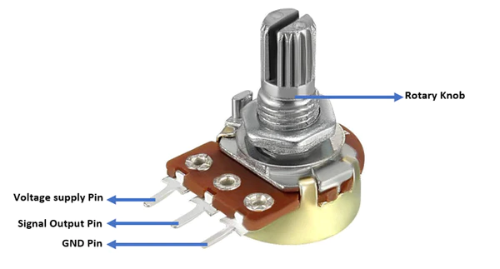

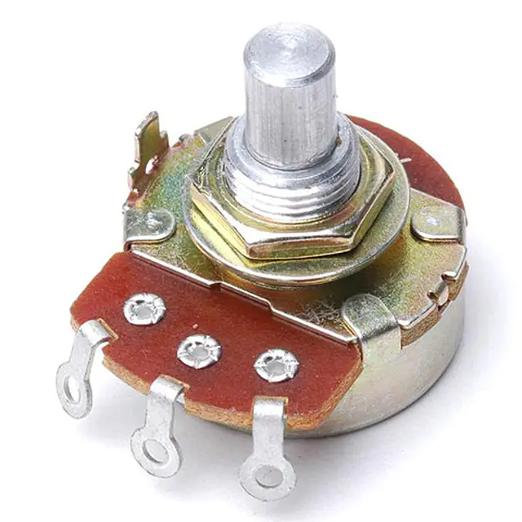
Project analysis slide 3
Purpose of each component
POTENTIOMETER
The Potentiometer (POT) is a passive electronic component.
The Potentiometer is used for adjusting various parameters like voltage, current…etc., in an electronic circuit.
Specifications:-
Resistance range- 0-10kilo ohms , resistance tolerance- ±10%
Connection of potentiometer in the circuit:
Connect middle terminal of potentiometer to VEE of LCD and remaining two terminals of potentiometer to GND and VCC one for each respectively

Slide 11
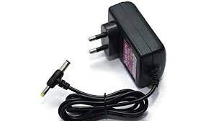
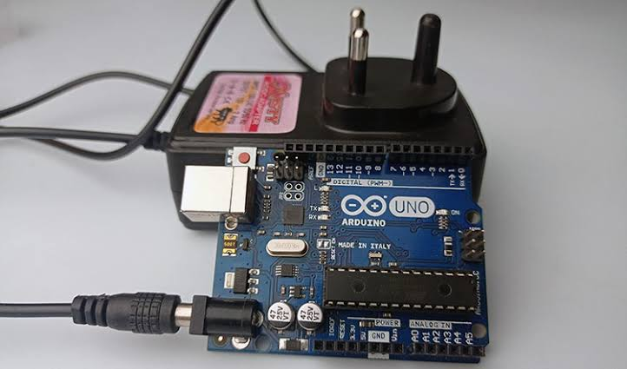
Project analysis slide 3
Purpose of each component
9v power adaptor
A 9V power adaptor is an electrical device that converts AC (alternating current) voltage from a wall outlet into a DC (direct current) voltage.
which can be used to power electronic devices.
Specification:- 9 volts and 1 ampere
Connection of power adaptor to arduino:
The power adaptor pin is connected to dc power jack of the arduino .The power adaptor provides 9 volts and 1 ampere current to arduino.

Slide 12
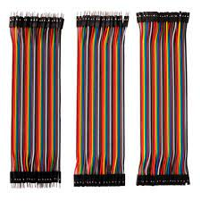
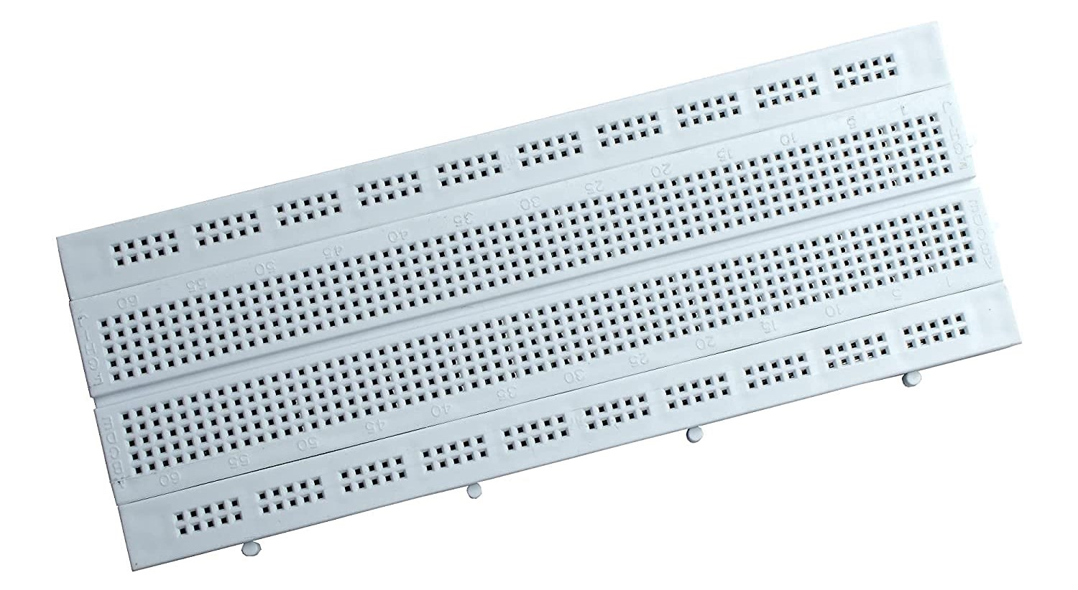
Project analysis slide 3
Purpose of each component
Jumper wires
Jumper wires are used for making connections between items on your breadboard and your arduino's header pins.
These are of three types they are male to male jumper , male to female jumper and female to female jumper.
breadboard
A breadboard is a device used to prototype electronic circuits. It is a flat board with holes that are arranged in a grid pattern.
The holes are used to insert components such as resistors, capacitors, diodes, and integrated circuits (ICs).
Breadboards are designed to allow quick and easy assembly of electronic circuits without the need for soldering.

Slide 13
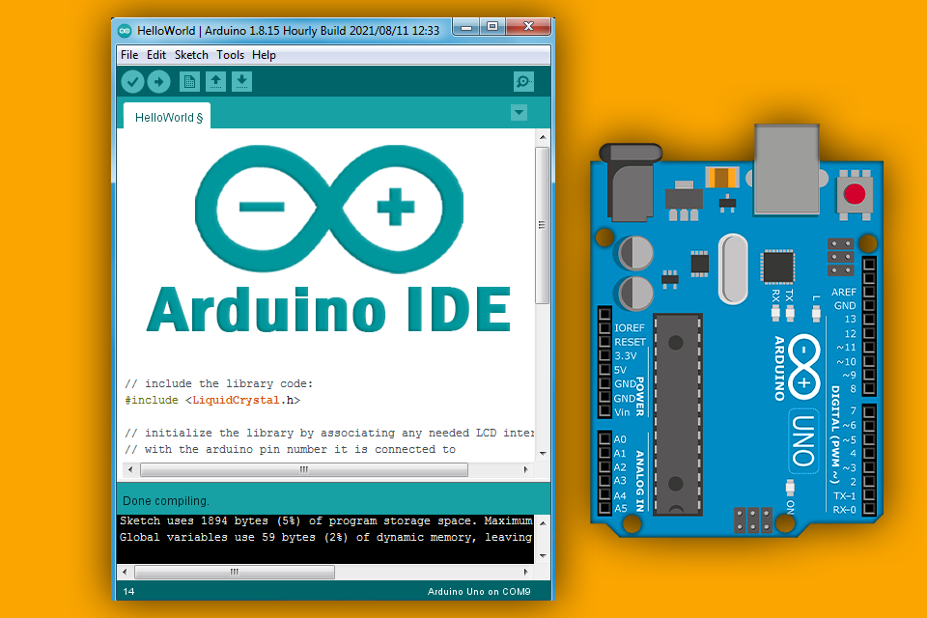

Project analysis slide 3
software components
Arduino ide software
Arduino IDE is an open source software.
This Arduino ide supports both C and C++ Language
The IDE environment mainly contains two basic parts:-
1.EDITOR:- It is used to write the required code
2.COMPILER:- It Is used for compiling and uploading the code into given Arduino module.
Embedded c language
Embedded C is most popular programming language in software field for developing electronic gadgets.
Embedded C programming plays a key role in performing specific function by the processor

Slide 14
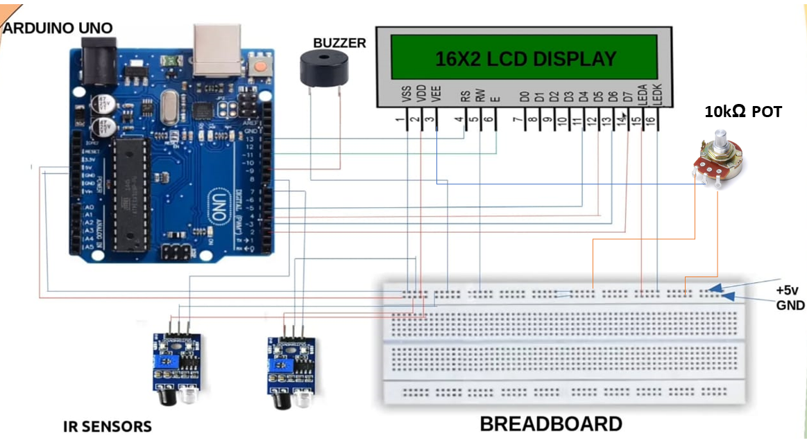
Project analysis slide 3
Circuit diagram

Slide 15
Project analysis slide 3
working
The basic working principle behind this circuit can be clearly observed from the block diagram.
Here two IR sensors are used to keep track of entry and exit of the persons.
The IR sensor gives an electrical signal as an output when an object comes in front of it.
By using the output electrical signal, the arduino can decide whether there is an obstacle or not.
Whenever any person passes from sensor-1 to sensor-2 it will be treated as entry and the count will be incremented.
Whenever any person passes from sensor-2 to sensor-1 it will be treated as exit and the count will be decremented.
If the counts equals to the density of the area then the LCDwill displays a message of “area is full”.
If the count exceeds the density of the area then the LCD will display that “the area has been over crowded”.
The buzzer will starts beeping inorder to alert the people and security team about the overcrowd.

Slide 16
Project analysis slide 3
ADVANTAGES
Low cost
Prevention of overcrowded accidents
No need of manpower
Less complex and more accurate
Can be implemented wherever single entry/exit point is present
Easy to setup and use

Slide 17
Project analysis slide 3
APPLICATIONS
Shopping malls
Political events
High-traffic areas
Offices
Temples
Transport field
Seminar halls
Schools and colleges
Parking areas

Slide 18


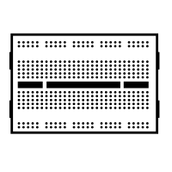

Progress of project
Components purchasing
Circuit connections
Coding of project
Prototype of projcet
We have successfully purchased all the components required for our project
Completed connections of the components according to circuit diagram
We have completed the coding part of our project
we have completed prototype of our project

Slide 19
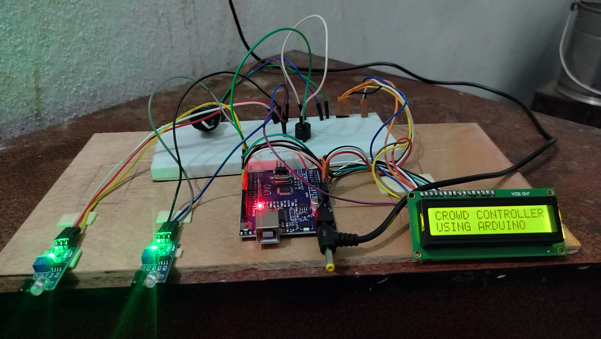
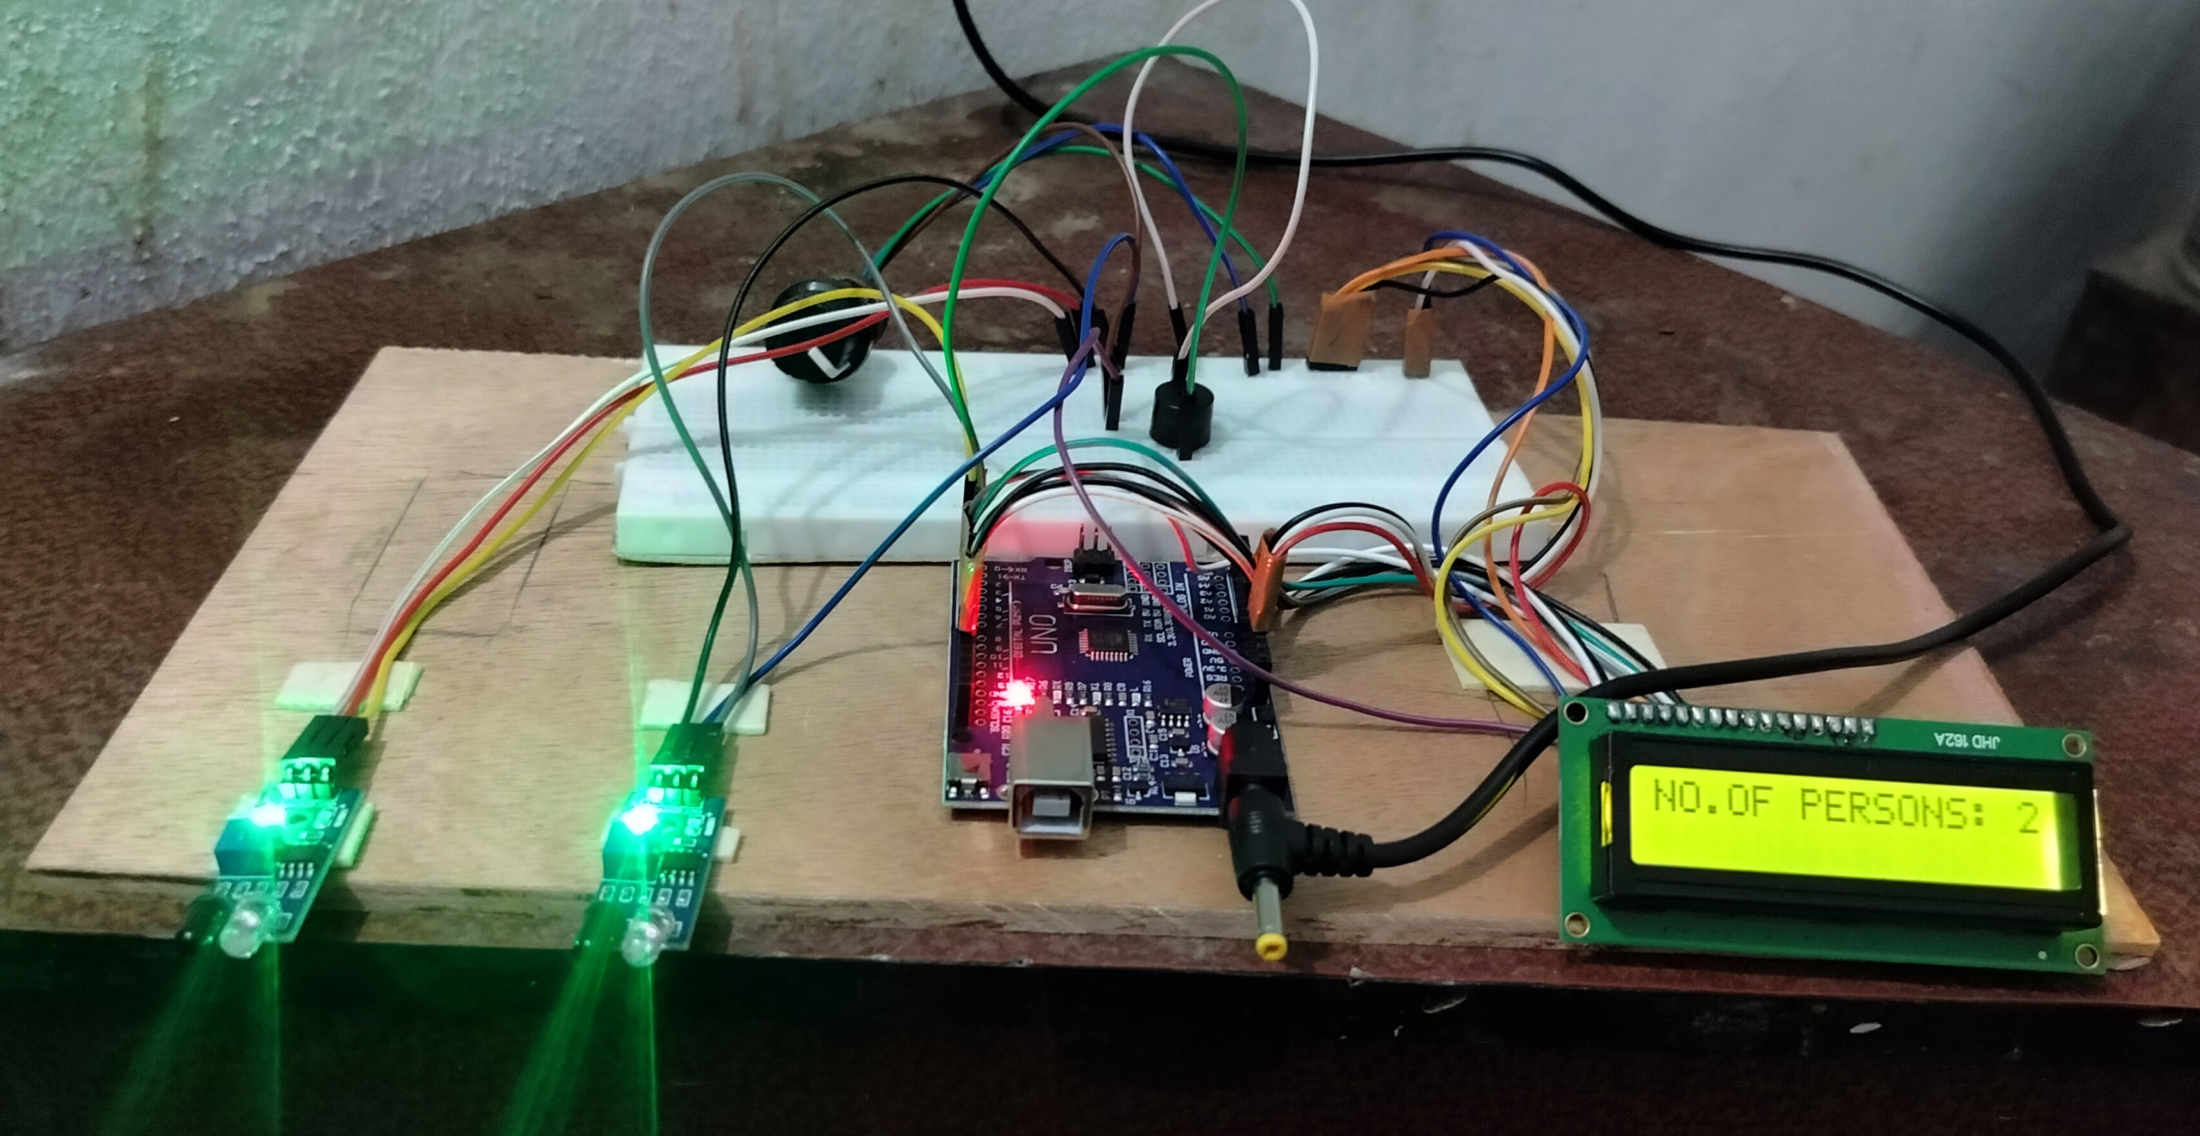
Project analysis slide 3
project prototype
Fig:- Increasing/Decreasing The Count When People Entering /Leaving The Area
Fig:- Title Of The Project

Slide 20
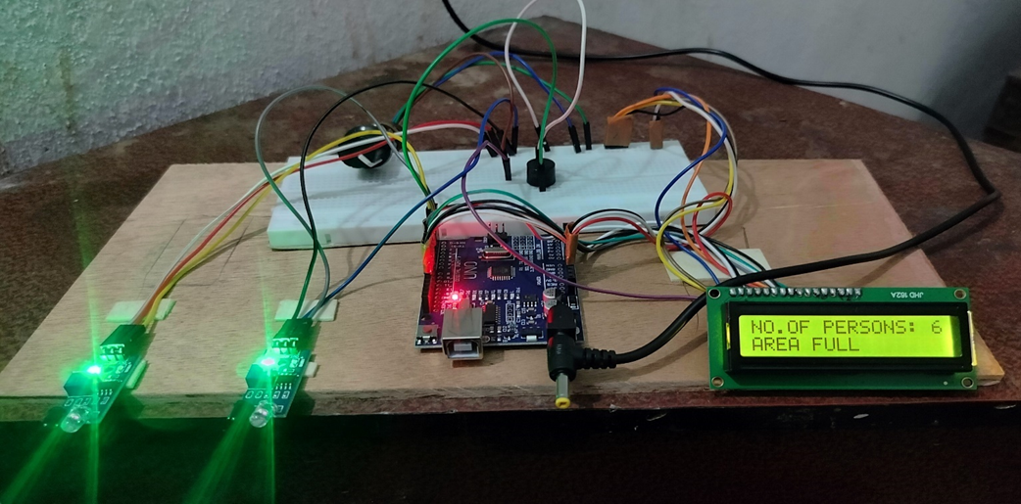
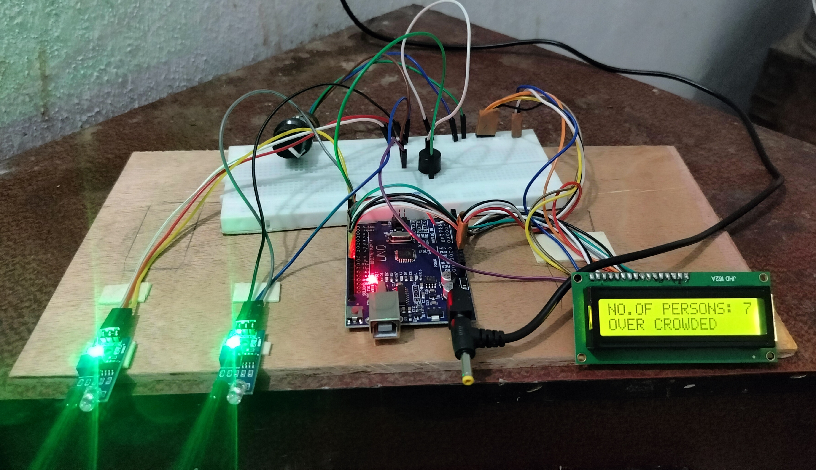
Project analysis slide 3
project prototype
Fig:- Displaying Alert Message When Area Has Been Filled
Fig:- Alerting When The Area Ha Been Overcrowded With The Help Of Buzzer And LCD

Slide 21

Project analysis slide 3
conclusion
This paper describes a circuit which is used for controlling crowd based on area density, according to the count of persons in the area and simultaneously works as a security system when the camera is attached.
The circuit counts the number of persons in a particular area.
It also designed to indicate the overcrowd with the help of LCD and buzzer.

Slide 22
Project analysis slide 3
FUTURE ENHANCEMENT
This crowd controller circuit is a real time application based and most useful one nowadays.
It works as a security system when camera is attached.
If we attach a small IC chip to the persons entering in the area , then we can monitor the movements of the people.
So that we can avoid missing cases in overcrowd areas and we can also able to monitor the health conditions of the people to help them in emergency cases.

Slide 23


Slide 24

Sincere regards,
D.Maheswari 20255-ec-032
J.L.D.Lavanya 20255-ec-045
G.V.Yeswanth 20255-ec-044
D.Mani Prasad 20255-ec-034
B.Kalpavalli 20255-ec-016
B.veerendra 20255-ec-019

